Slide 1
Heaps

Slide 2
The ADT Heap
A heap is a complete binary tree that either is
  Empty or …
  Whose root contains a value ≥ each of its children
  and has heaps as its subtrees
It is a special binary tree … different in that
  It is ordered in a weaker sense
  it will always be a complete binary tree

Slide 3
The ADT Heap
A heap is a complete binary tree that either is
  Empty or …
  Whose root contains a value ≥ each of its children
  and has heaps as its subtrees
It is a special binary tree … different in that
  It is ordered in a weaker sense
  it will always be a complete binary tree
Full Binary Tree: A binary tree in which all of the leaves are on the same level and every nonleaf node has two children
Complete Binary Tree: A binary tree that is either full or full through the next-to-last level, with the leaves on the last level as far to the left as possible

Slide 4
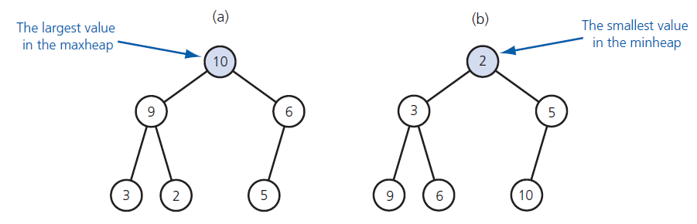
The ADT Heap
(a) A maxheap and (b) a minheap

Slide 5
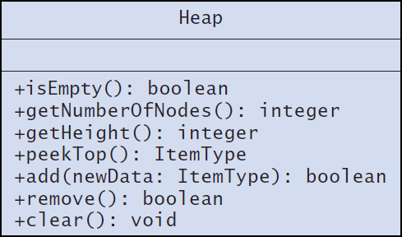
The ADT Heap
UML diagram for the class Heap

Slide 6
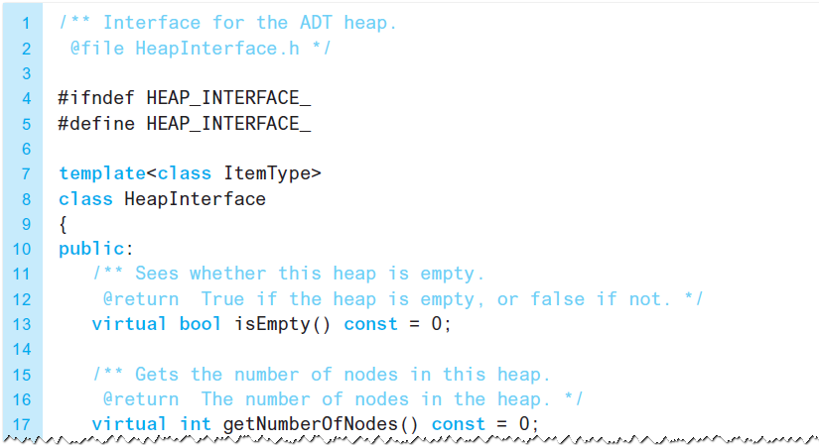
The ADT Heap
An interface for the ADT heap

Slide 7
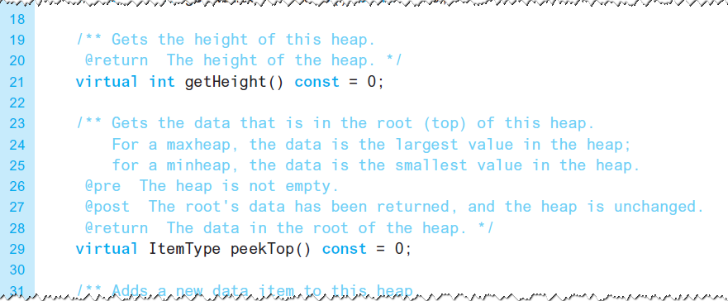
The ADT Heap
An interface for the ADT heap

Slide 8
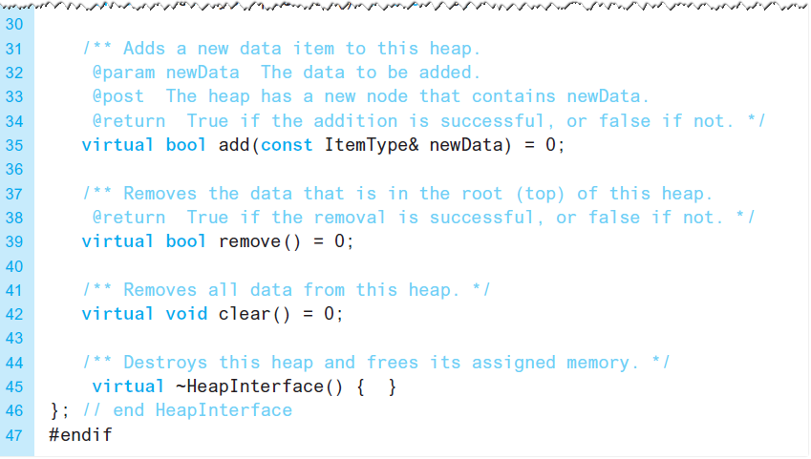
The ADT Heap
An interface for the ADT heap

Slide 9
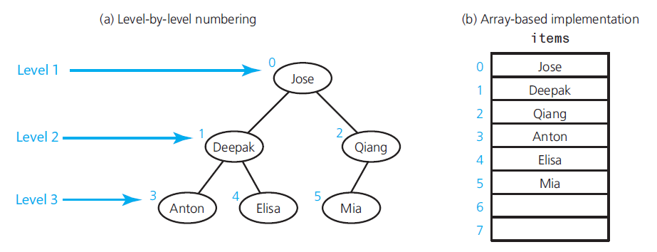
Array-Based Implementation of a Heap
A complete binary tree and its
array-based implementation

Slide 10
Algorithms for Array-Based
Heap Operations
Assume following private data members
  items: an array of heap items
  itemCount: an integer equal to the number of items in the heap
  maxItems: an integer equal to the maximum capacity of the heap

Slide 11
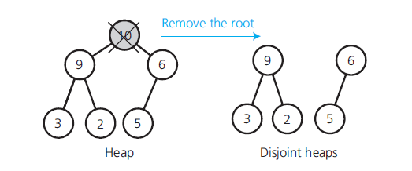
Algorithms for Array-Based
Heap Operations
Disjoint heaps after removing the heap’s root

Slide 12
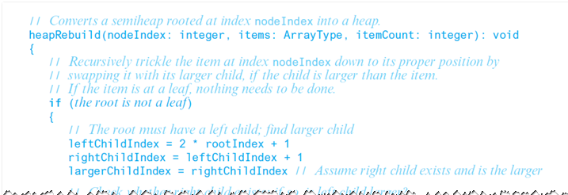
Algorithms for Array-Based
Heap Operations
Recursive algorithm to transform semiheap to heap.

Slide 13
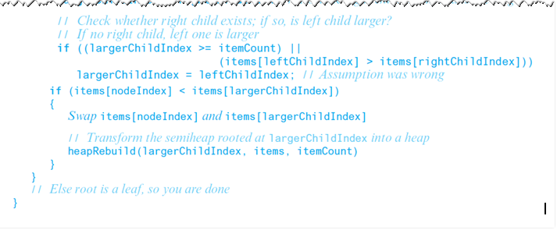
Algorithms for Array-Based
Heap Operations
Recursive algorithm to transform semiheap to heap.

Slide 14
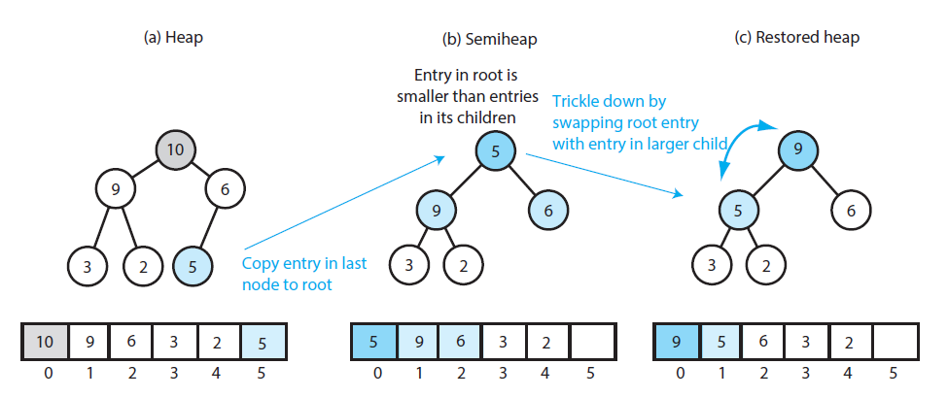
Algorithms for Array-Based
Heap Operations

Slide 15
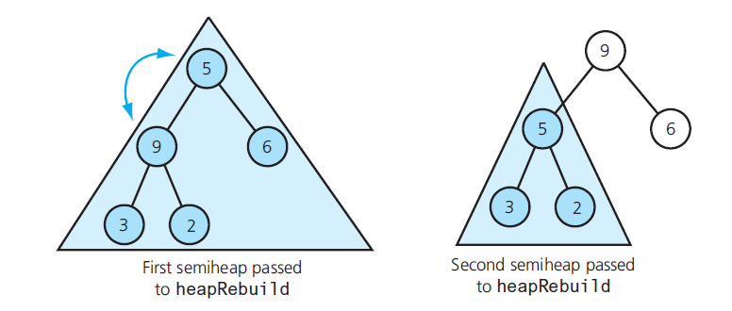
Algorithms for Array-Based
Heap Operations
Recursive calls to heapRebuild

Slide 16
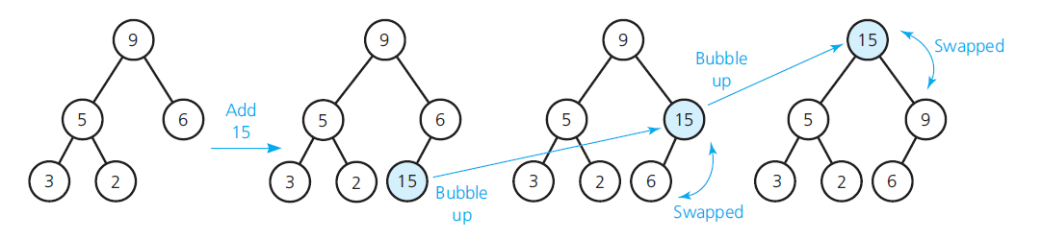
Algorithms for Array-Based
Heap Operations
Adding 15 to a heap

Slide 17
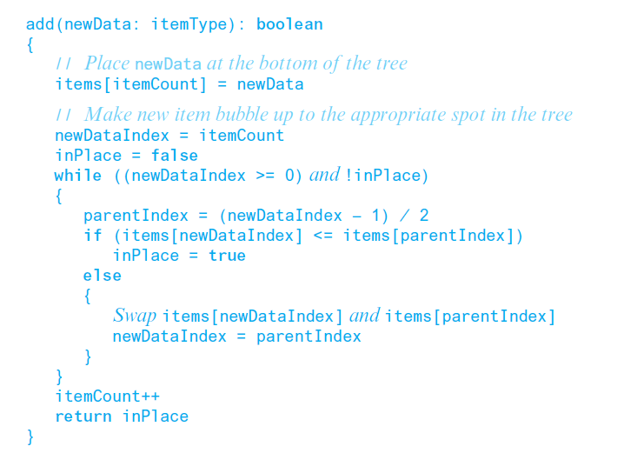
Algorithms for Array-Based
Heap Operations
Pseudocode for add

Slide 18
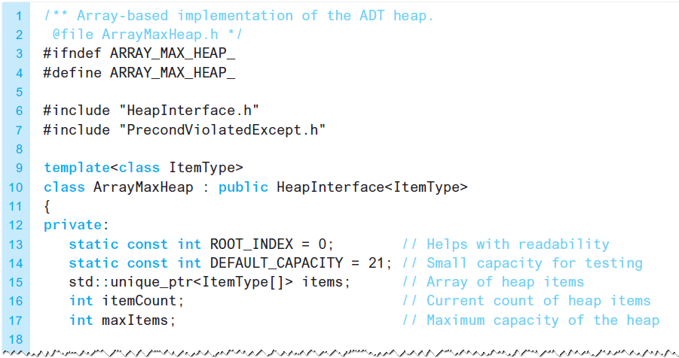
The Implementation
The header file for the class ArrayMaxHeap

Slide 19
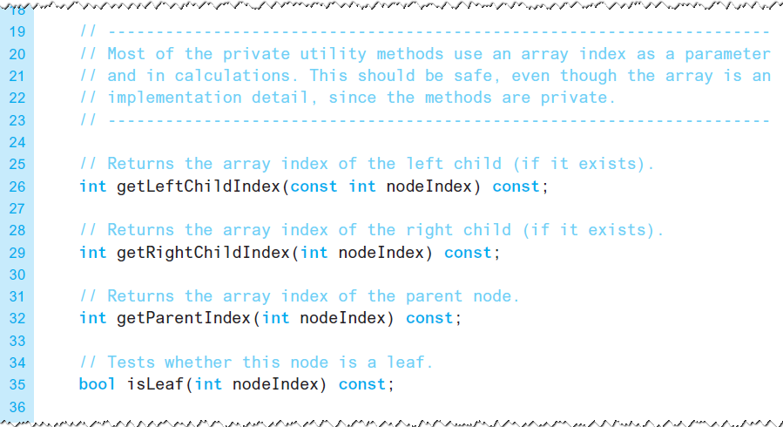
The Implementation
The header file for the class ArrayMaxHeap

Slide 20
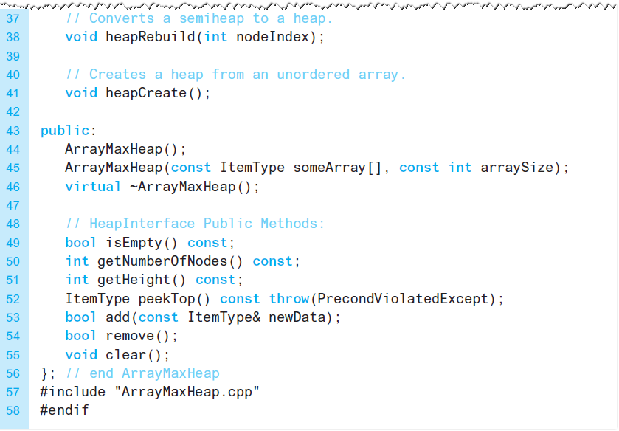
The Implementation
The header file for the class ArrayMaxHeap

Slide 21
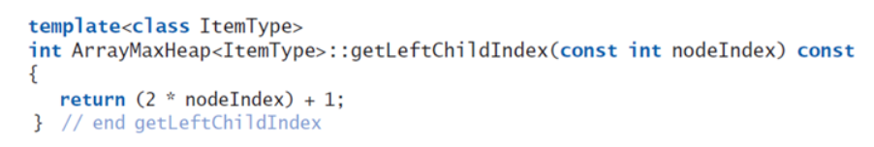
The Implementation
Definition of method getLeftChildIndex

Slide 22
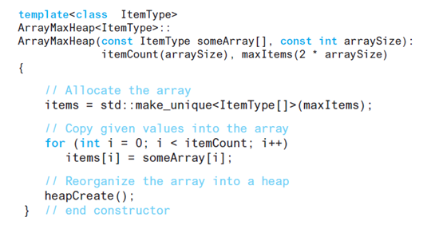
The Implementation
Definition of the constructor

Slide 23
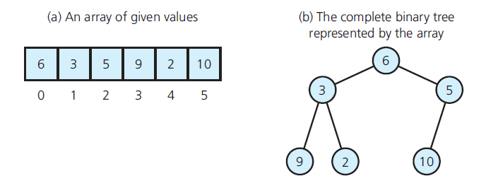
The Implementation
Array and its corresponding complete binary tree

Slide 24
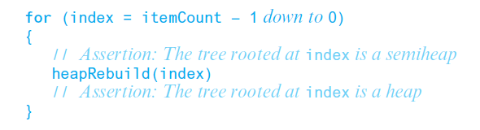
The Implementation
Building a heap from an array of data

Slide 25
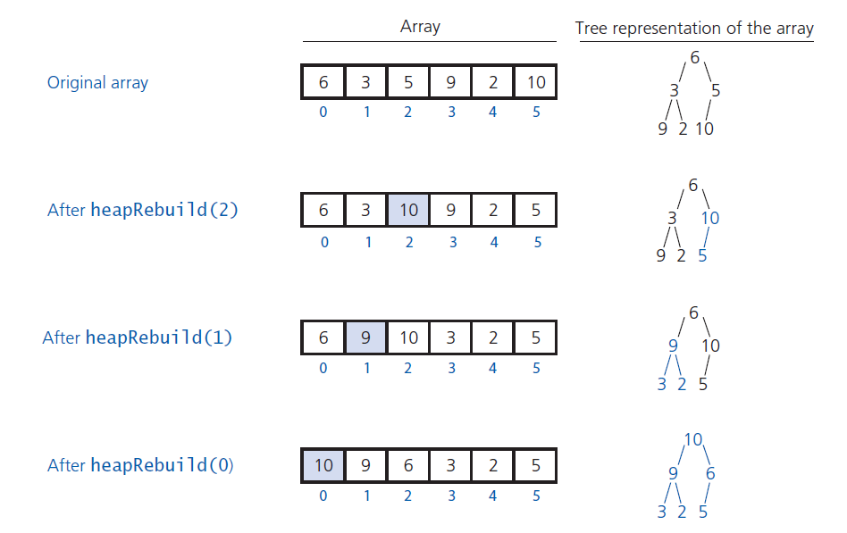
The Implementation
Transforming an array into a heap

Slide 26
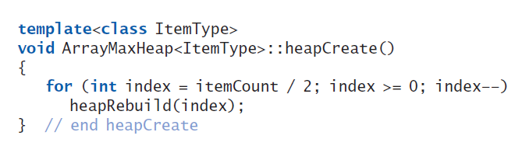
The Implementation
C++ method heapCreate

Slide 27
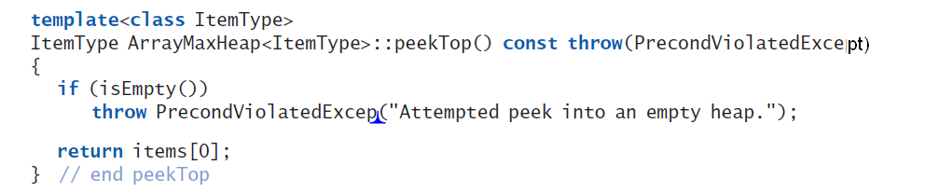
The Implementation
C++ method peekTop which tests for an empty heap

Slide 28
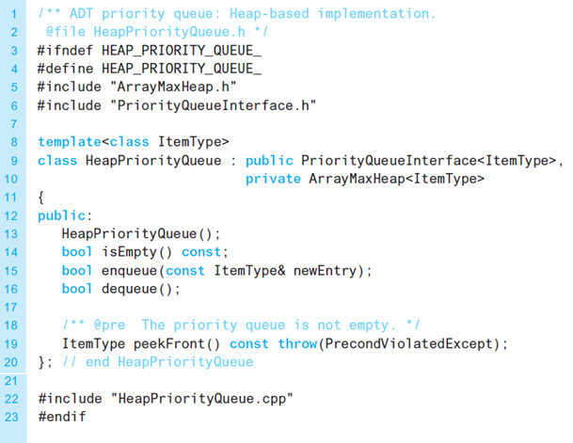
Heap Implementation of the ADT Priority Queue
A header file for the class HeapPriorityQueue

Slide 29
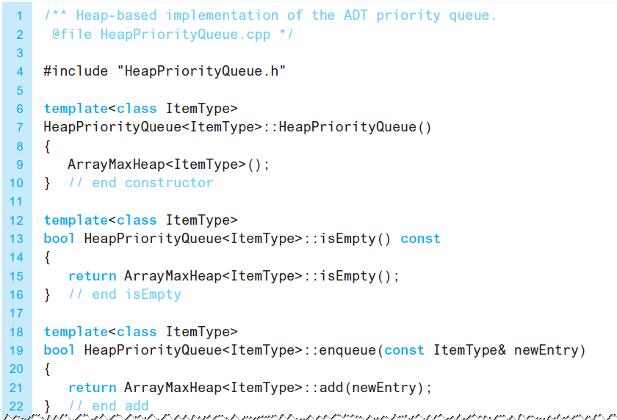
Heap Implementation of the ADT Priority Queue
An implementation of the class HeapPriorityQueue

Slide 30
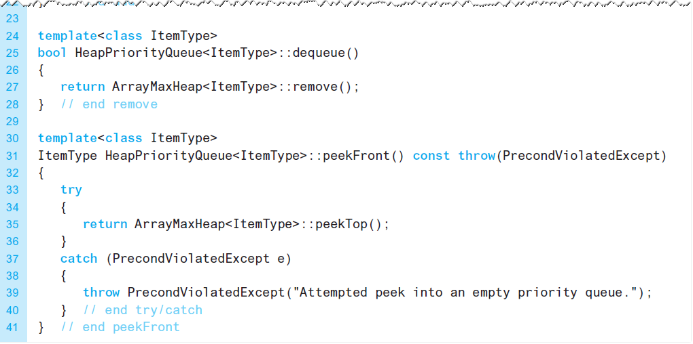
Heap Implementation of the ADT Priority Queue
An implementation of the class HeapPriorityQueue

Slide 31
Heap Implementation of the ADT Priority Queue
Heap vs. a binary search tree
  If you know maximum number of items in the priority queue, heap is the better implementation.
Finite, distinct priority values
  Many items likely have same priority value
  Place in same order as encountered

Slide 32
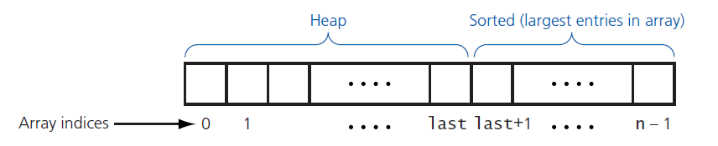
Heap Sort
Heap sort partitions an array into two regions

Slide 33
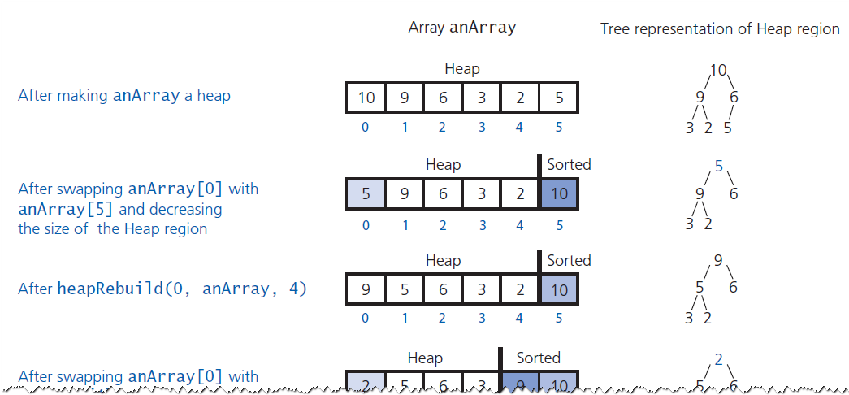
Heap Sort
A trace of heap sort

Slide 34
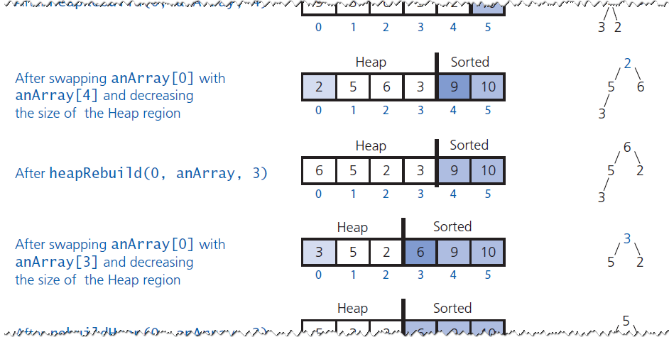
Heap Sort
A trace of heap sort

Slide 35
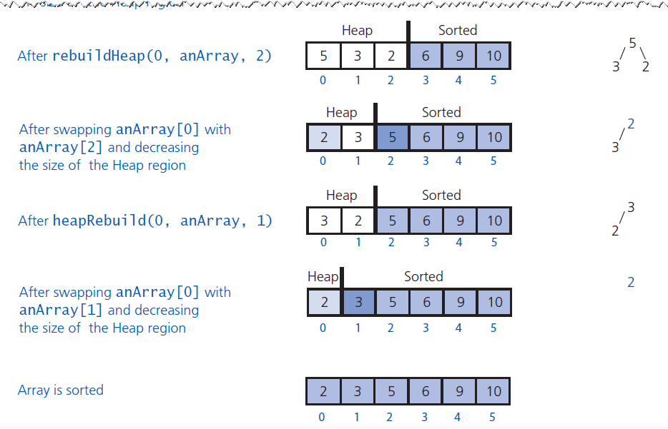
Heap Sort
A trace of heap sort

